Slide 1

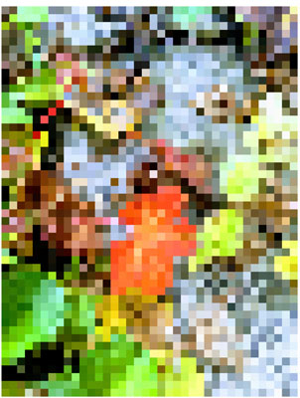
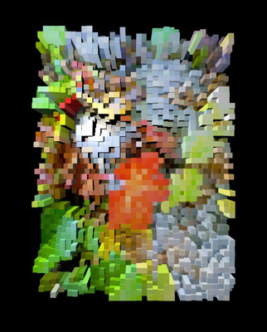
BlockCam Image Process Flow
Color Array Source
Color Array
(in memory)
Data Reduction
Data Parse
Create 3D Nodes
or
Saved Parsed Data
Color Array
(from storage)
Device File System
Image Parameter Changes
from UI
Create 3D Nodes
Parsed Data

